Slide 1
Akash Singh
IIT ISM DHANBAD 2023

Slide 2




Factors that influence US home prices
What Factors influence the Residential home prices across U.S the most( last 20 years) using a data science model.

Slide 3
About DataSet
The dataset contains key factors that could influence Residential home prices in the last 20 years in the United States. This factor falls into two categories i.e. Supply & Demand
The S&P Case-Shiller Housing Price Index(HPI) is taken as the y variable, or dependent variable, as an indicator of change in prices.
PROCESS:
Understanding dataset Data Cleaning Mearged into one dataset
Checking outliers Plotted Graphs to check trends between them
Model Building Conclusion

Slide 4
Understanding dataset
Key supply-demand factors that influence US home prices
Supply
1.Building Permits(Permit Number) Number of building permits allotted
2..Construction Spending (Million $ )
The amount spent (in millions of USD) is a measure of the activity in the construction industry.
3. Housing Starts(New Housing Project)
This is a measure of the number of units of new housing projects started in a given period.
4.Homes Sold
House for sale is a basic measure of supply.
Demand
1.Mortgage Rates(%)
The interest rate charged for a home loan
2.USA GDP(Billions$ )
Quarterly Real GDP (adjusted for inflation)
3.Unemployment(%)
4.Delinquency Rate on Mortgages
(Foreclosure on mortgage)
An indicator of the number of
foreclosures in real estate.

Slide 5
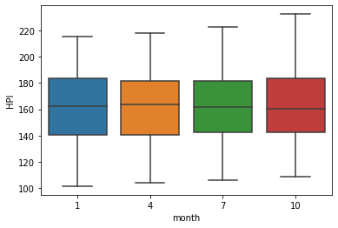
DATA CLEANING
DEMAND
# Column Non-Null Count Dtype
0 DATE 84 non-null object
1 UNEM_RATE 84 non-null float64
2 MORTGAGE 84 non-null float64
3 GDPC1 84 non-null float64
4 FORECLOSURES 84 non-null float64
5 HPI 84 non-null float64
dtypes: float64(5), object(1)
SUPPLY
# Column Non-Null Count Dtype
--- ------ -------------- -----
0 Period 250 non-null object
1 Permit_Number 250 non-null int64
2 construction 250 non-null int64
3 Homes_Sold 250 non-null int64
4 Housing_Starts 250 non-null int64
dtypes: int64(4), object(1)

Slide 6
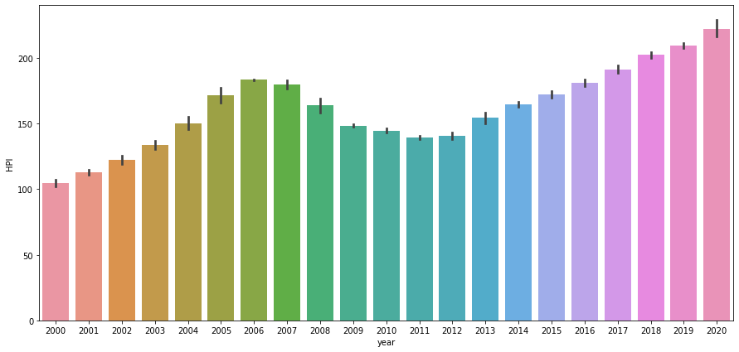
Graphs
HPI VS year trends

Slide 7
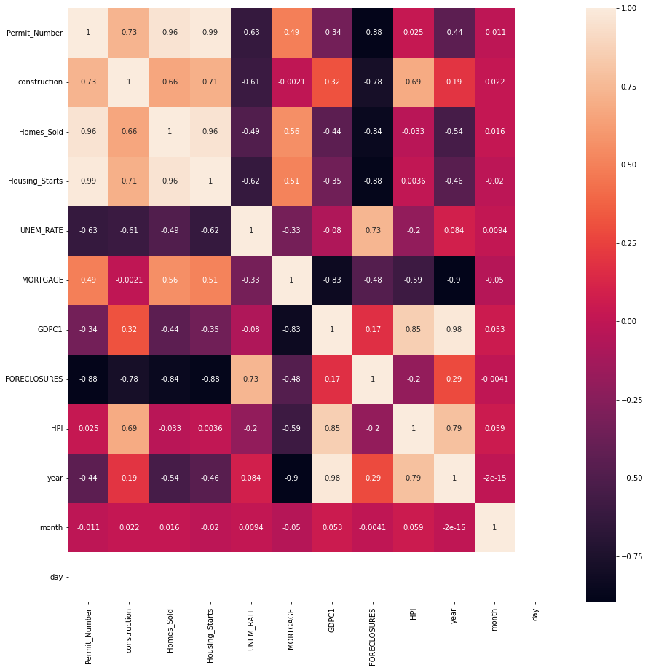
Correlation
GDPC and Construction have strong correlation with HPI

Slide 8
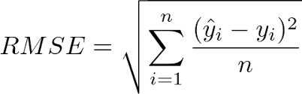
Model Training | Linear Regression
0 | Permit_Number | -0.021176
1 | construction | 0.000179
2 | Homes_Sold | 0.001194
3 | Housing_Starts | -0.009498
4 | UNEM_RATE | 5.802166
5 | MORTGAGE | -1.273404
6 | GDPC1 | 0.030675
7 | FORECLOSURES | -2.587455
8 | year | -6.484919
9 | month | -0.590118
10 | day | 0.000000
Coffecient
Root Mean Square Error(RMSE)
For this model
RMSE=4.403961068328888
ACCURACY=0.971794

Slide 9
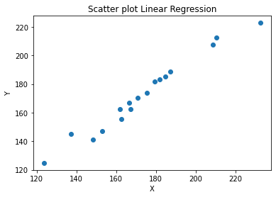
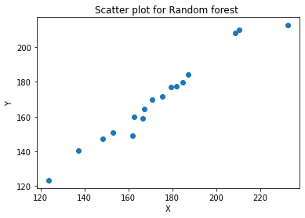
RandomForestRegressor
For this model
RMSE=6.577843455472821
ACCURACY=0.937077

Slide 10
CONCLUSION
Considering the accuracy and error of both models , the Linear Regression model is better for this Dataset .
The Equation for HPI in terms of the features is :
HPI = 12655.62 -0.02 * permit_NO + 0.00 * construction + 0.00 * Homes_sold - 0.01 *
Housing_starts +5.80 * UNEM_rate - 1.27 * mortage+ 0.03 * GDPC1 -2.59 * Foreclousers -
6.48 * year -0.59 *month + 0.00*day

Slide 11

Contact
Akash Singh
+91 6306438211
akash04singh11@gmail.com
http://www.linkedin.com/in/akash-singh04

